Slide 1
Internship Erasmus+
Test Project
https://www.inbestme.com
Salih Can, salih.can@inbestme.com
Ferad Zyulkyarov, ferad.zyulkyarov@inbestme.com
17/12/2020

Slide 2
Introduction
This presentation is to explain an example test project.
In the project, there will be 3 tasks to be done:
Comparing historical performance of accounts with inflation rates
Relationship between wealth, age and funded amount (Open end)
Relationship between total return of users and their Mifid scores (Open end)
Each task and the data to be used will be explained in the following slides.
Note: Task 2 and 3 is open end which means it is up to you which algorithms you’d like to use.

Slide 3
Data
AccountsInvestorSurvey.xlsx
SignInLog.xlsx
Account information as of last date.
Logins for every account (when the account logged in).
InvestorAccountHistory.xlsx
InflationRates.xlsx
Historical data for every account. Returns for each account
Inflation rates for Spain each month (CPI)
For more information, please check the comment in the files for details what each column means.

Slide 4
Task 1: Comparing historical performance of accounts with inflation rates
In the InvestorAccountHistory.xlsx, there are daily records for each account. Daily records for each account starts when initial fund is made until all of money is withdrawn. Also there is additional file (InflationRate.xlsx) which comprises inflation rate of Spain for each month.
Objective: We would like to see how many accounts in total performed better than inflation rates in terms of total return?
An example provided in the next slide.

Slide 5
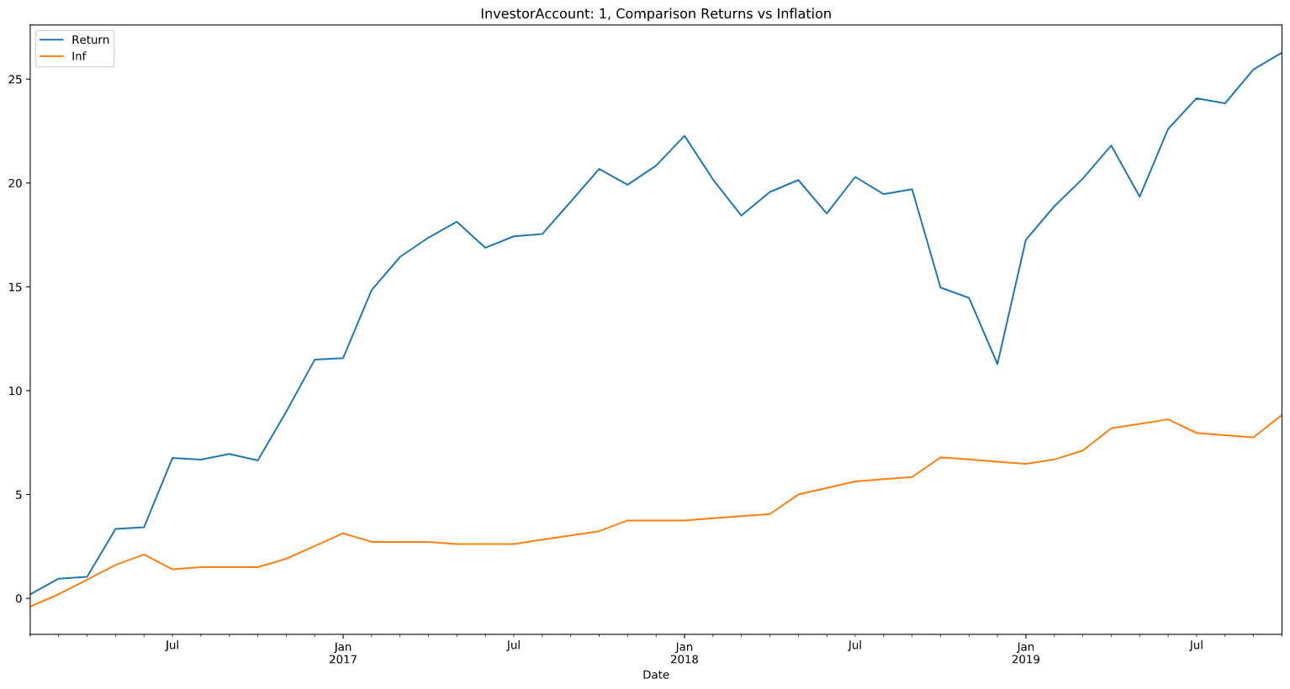
Task 1: Example
We take InvestorAccount 1. Then check its returns vs inflation. In the graph, it can be seen easily account performed better inflation.

Slide 6
Task 2: Relationship between wealth, age and funded amount
In the AccountInvestorSurvey.xlsx, there are informations related to each account. Also initial funds can be extracted using InvestorAccountHistory.xlsx; first value for each account.
Objective: We would like to see if there is any relationship between wealth-age and initial funded amount.

Slide 7
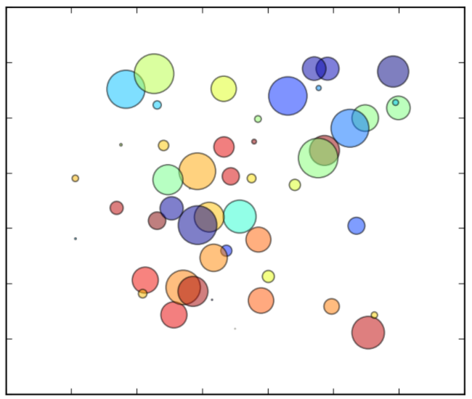
Task 2: Example
Each circle represents initial funded amount, larger circle indicates more initial fund is made.
Wealth increases
Wealth
Example 1, initial fund 10.000 euro
Example 2, initial fund 80.000 euro
Age
Age increases

Slide 8
Task 3: Relationship between total return of users and their Mifid scores
In the AccountInvestorSurvey.xlsx, there is field called Mifid. This indicates the risk of the portfolio user preferred. Also end total return for the account can be extracted from InvestorAccountHistory.xlsx.
Objective: We would like to see the relationship between total return of account and their mifid scores.
An example provided in the next slide.

Slide 9
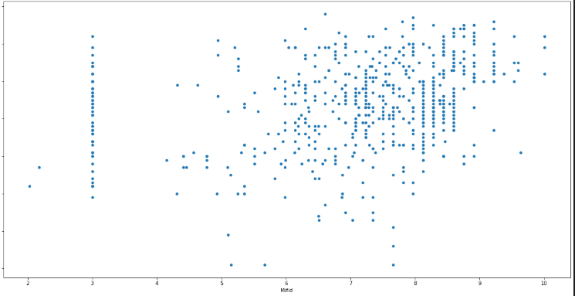
Task 3: Example
returns %
mifid scores
An example scatter plot to see the relationship between returns of the clients and mifid scores. Many analysis could be made on top of this.

Slide 10
Due Dates
Due date for the test project is 25/12/2020, one week later. Good luck!

Slide 11
Tools
It is up to you which tools you’d like to use. As the language of Data Science is Python, I highly recommend it.
Libraries:
Pandas
Scikit
Keras (for ML purposes, out of the box.)
Pytorch (for ML purposes, more configurable)
Also I highly recommend Jupyter Notebook to play around with the data.

